Slide 1

NSG Pilkington – University of Liverpool Machine Learning Project: 03/02/2021
Dr. Peter Green
Diego Echeverria
Risk Institute,
School of Engineering

Slide 2
List of activities
Use the uncorrelated inputs provided by the team to avoid identifying relevant tags that will cancel out.
Tune the regularisation parameter and see if there are any changes in the MSE scores.
Bespoke filtering after identifying relevant inputs using the uncorrelated tags.
Check if there is any changes in the MSE scores.

Slide 3
Removing Correlated Inputs
 | LR | GP
Test (1) | 0.0014 | 0.0130
Test (2) | 0.0027 | 0.031
Score | 0.00205 | 0.0220
With correlated inputs (last week’s results):
 | LR | GP
Test (1) | 0.00043 | 0.00393
Test (2) | 0.00129 | 0.00597
Score | 0.00086 | 0.00495
Correlated inputs removed:

Slide 4
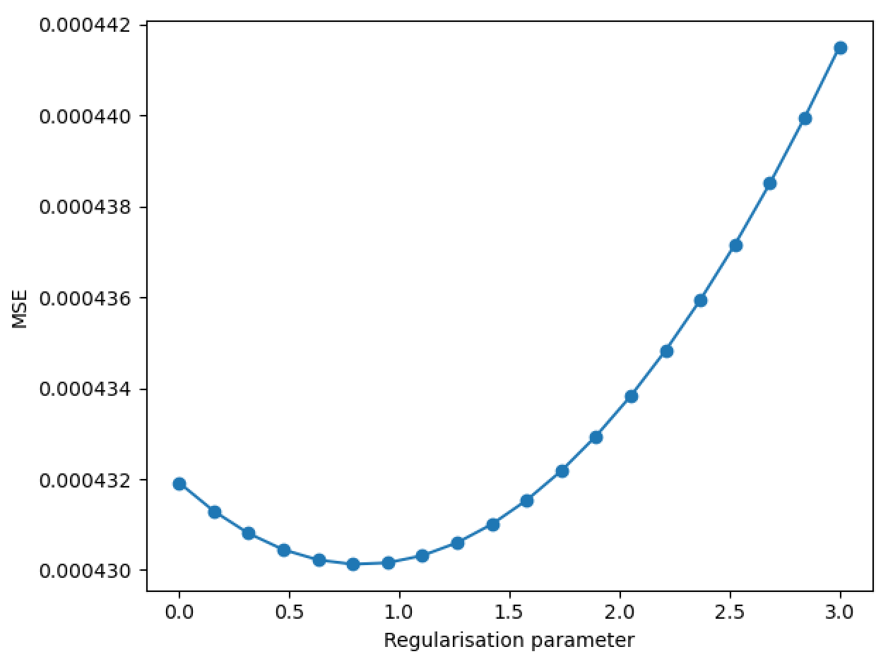
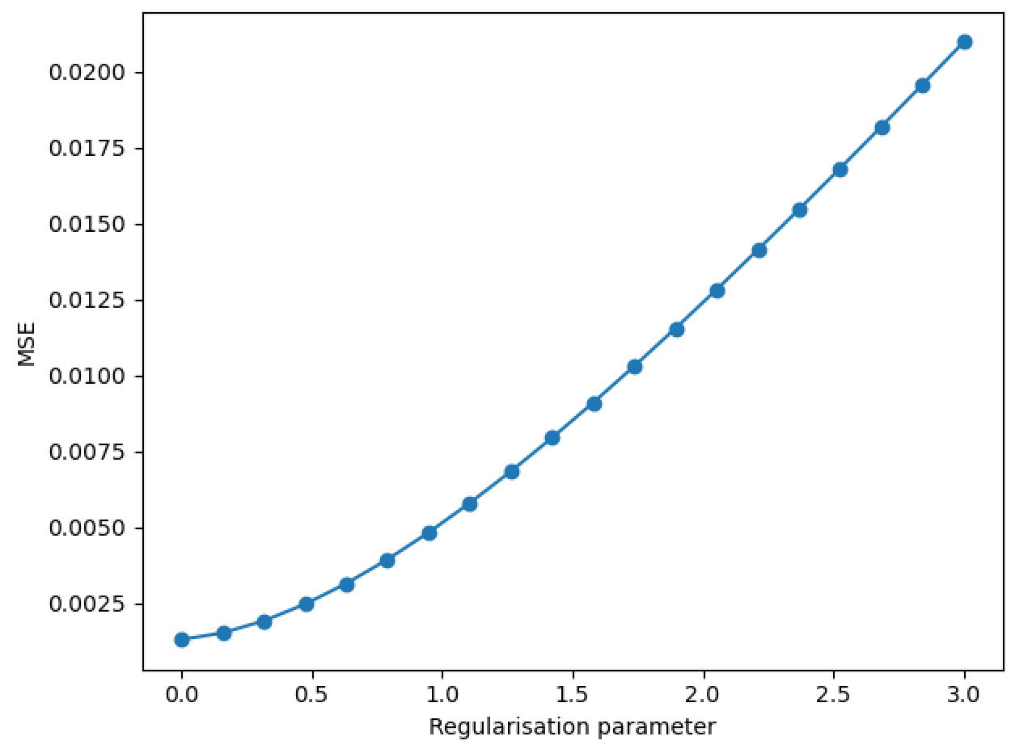
Tuning Regularisation Parameter
Test 1
Test 2
Different optimal regularisation parameters for the 2 cases.
Test 1 is not very sensitive to changes.
May as well choose a small value, which works for the (more challenging) test 2.

Slide 5
Tuning Regularisation Parameter
Test 1
Test 2
Different optimal regularisation parameters for the 2 cases.
Test 1 is not very sensitive to changes.
May as well choose a small value, which works for the (more challenging) test 2.
 | LR | GP
Test (1) | 0.00043 | 0.00393
Test (2) | 0.00129 | 0.00597
Score | 0.00086 | 0.00495
(scores remain the same)

Slide 6
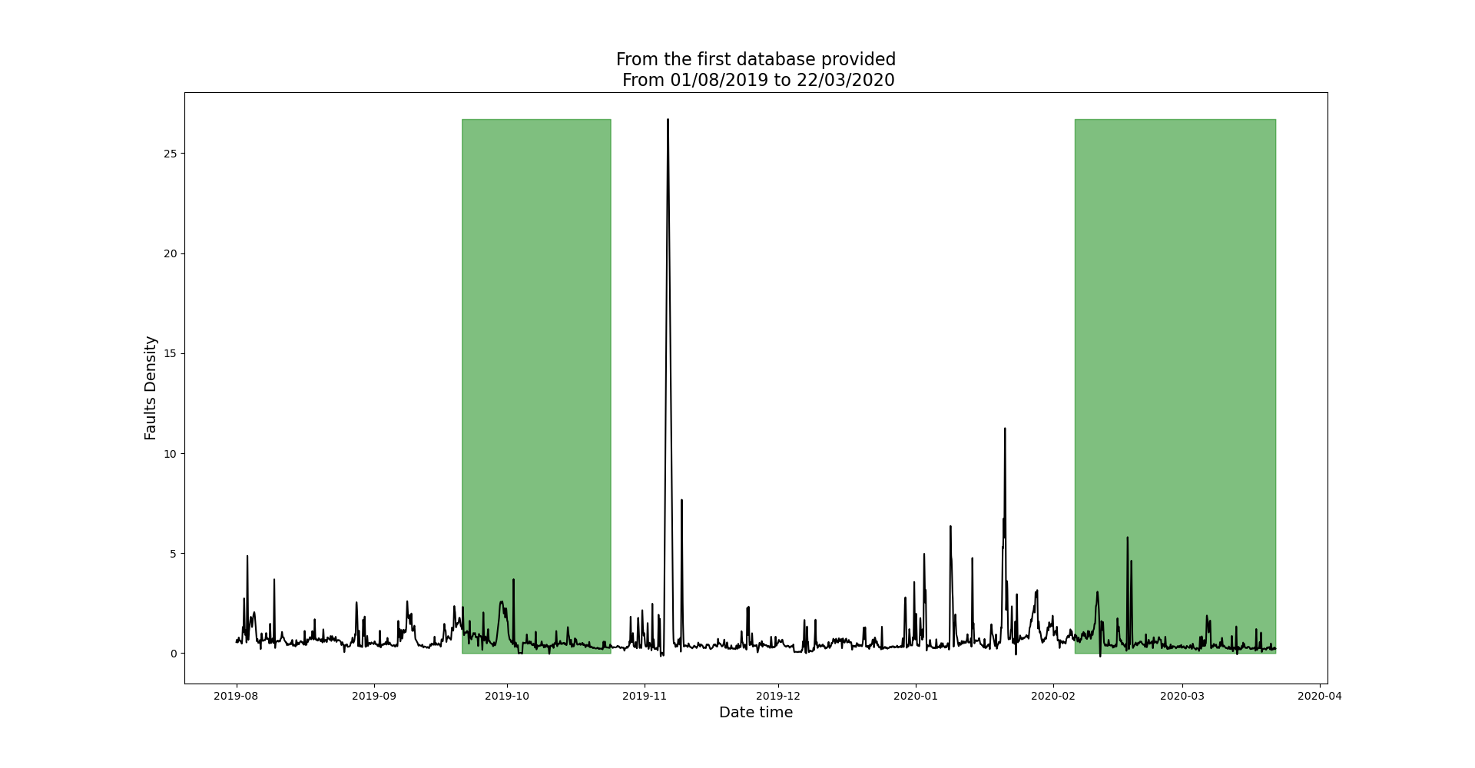
Test (1): Data from the first region is used for training
Clean regions
ISRA 5D
Training
Testing

Slide 7
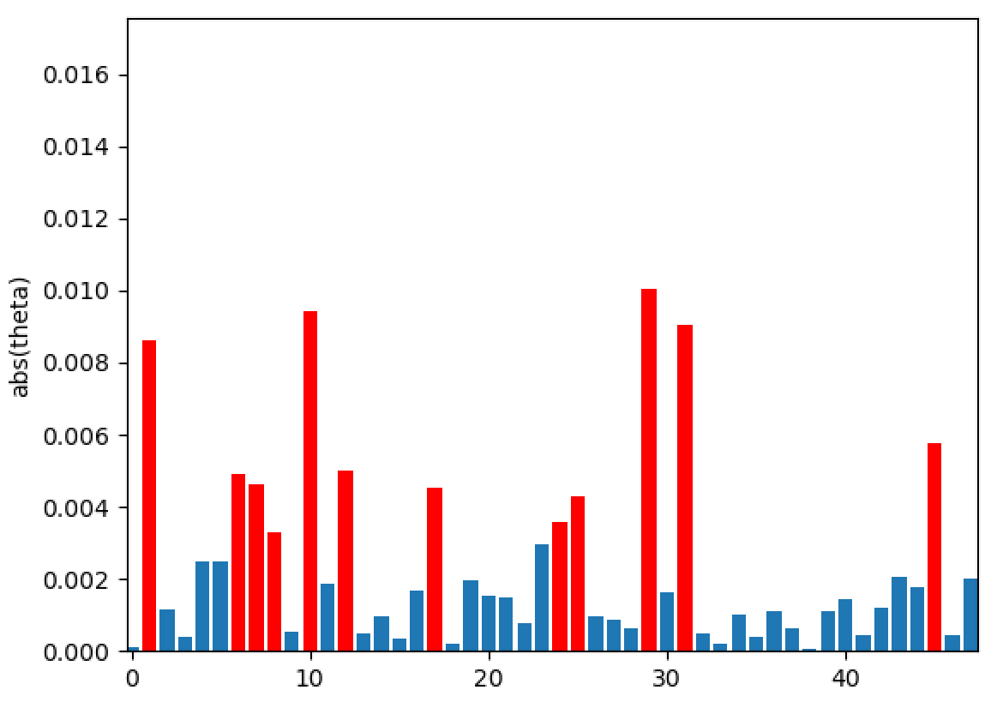
Test (1): Identified relevant inputs
10425 Calculated Cullet Ratio
2913 Closed Bottom Temperature - Port 1 (PV)
2918 Closed Bottom Temperature - Port 6 (PV)
2921 Closed Bottom Temperature - Upstream Working End (PV)
30208 Feeder Speed Measurement Left
10091 Furnace Load
9395 Main Gas Pressure (OP)
7520 Open Crown Temperature - Upstream Working End (PV)
7443 Outside Ambient Temperature Measurement
11111 Port 2 - 3 Combustion Air Flow LHS (OP)
9400 Port 2 Gas Flow (SP)
9282 Tweel Position

Slide 8
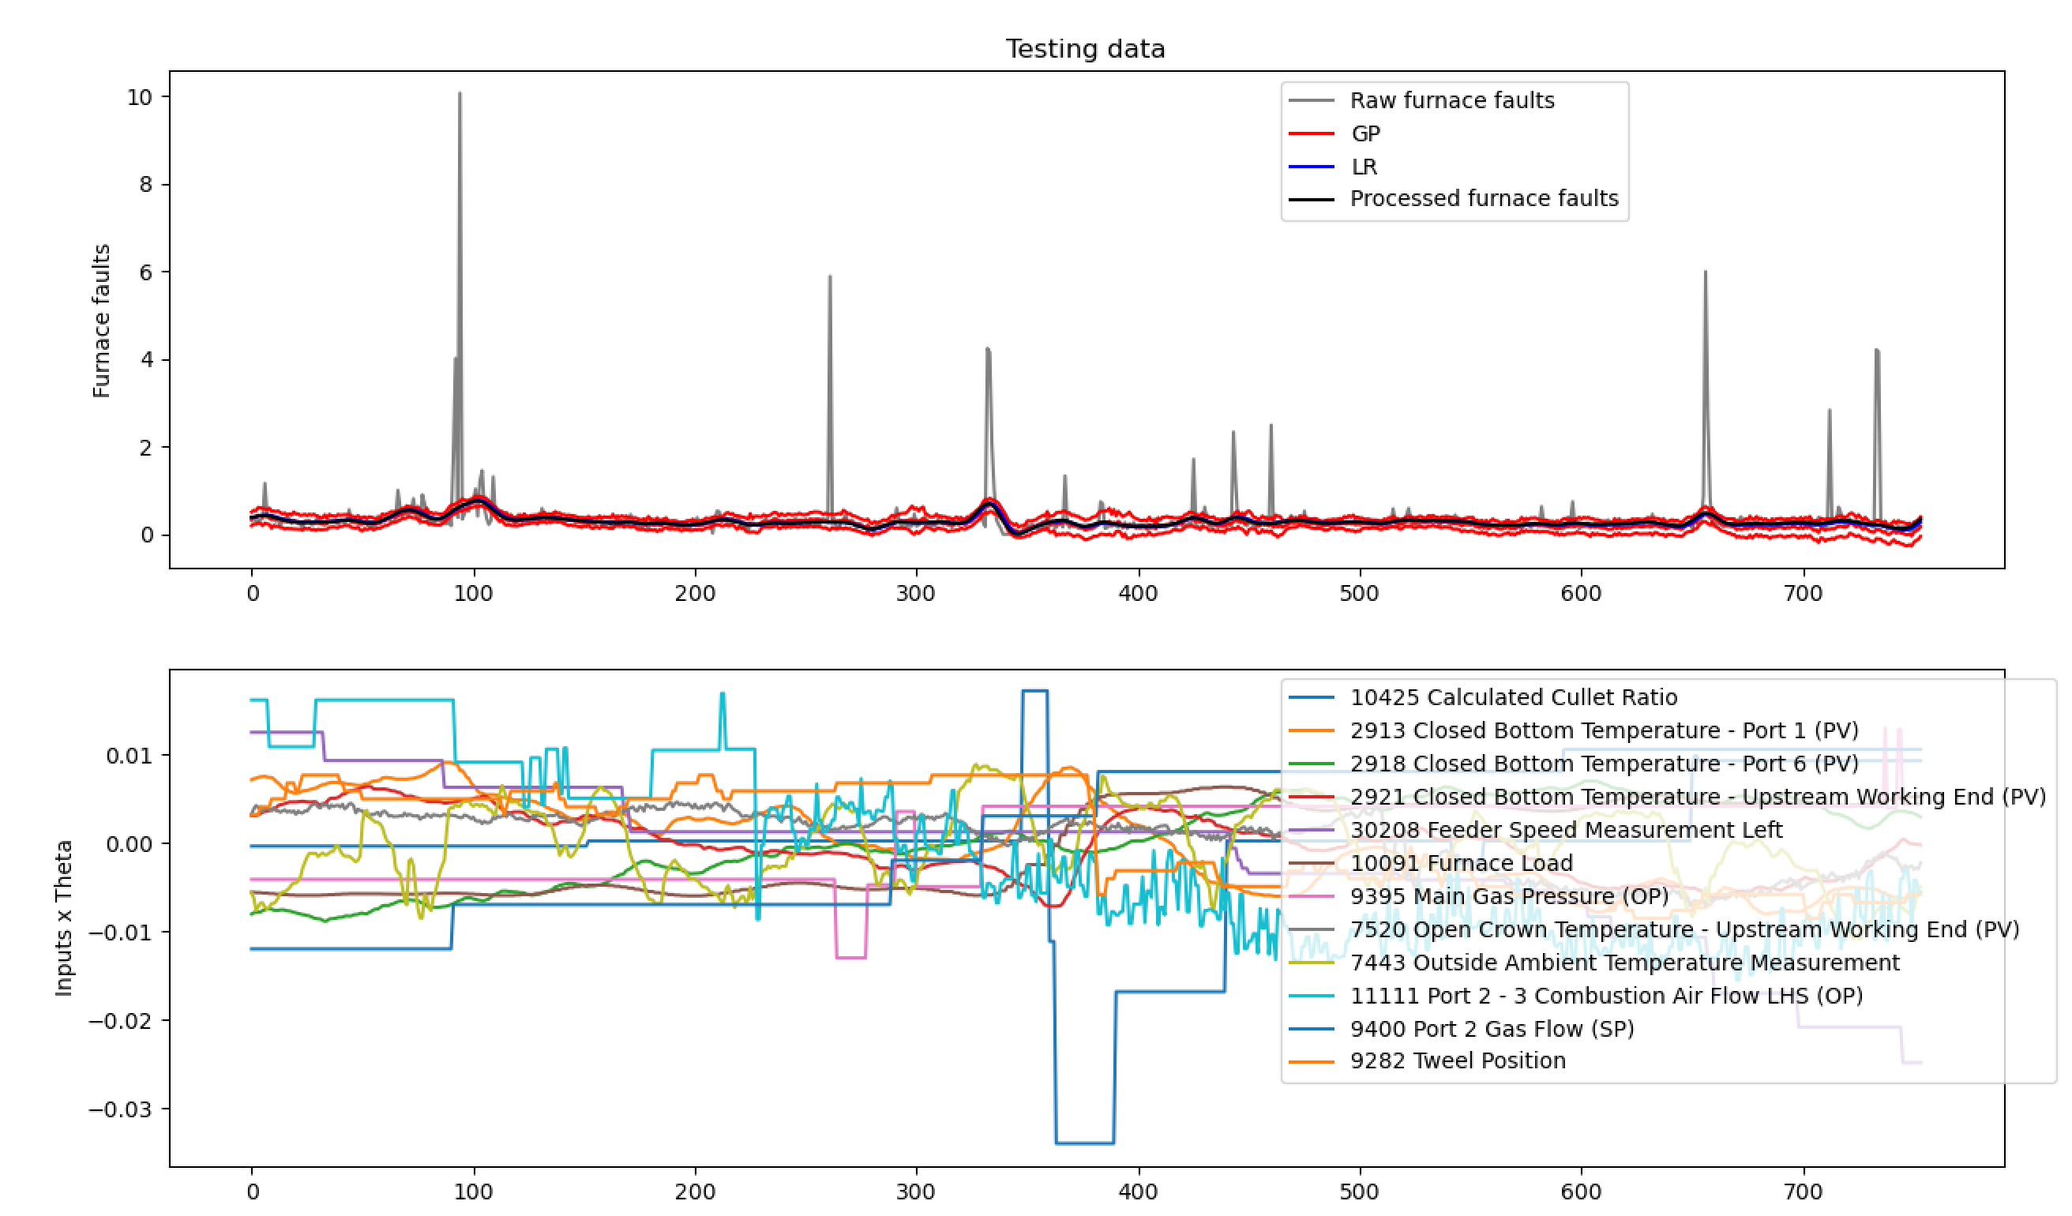
Test (1)

Slide 9
Test (2): Data from the second region is used for training
Clean regions
ISRA 5D
Testing
Training

Slide 10
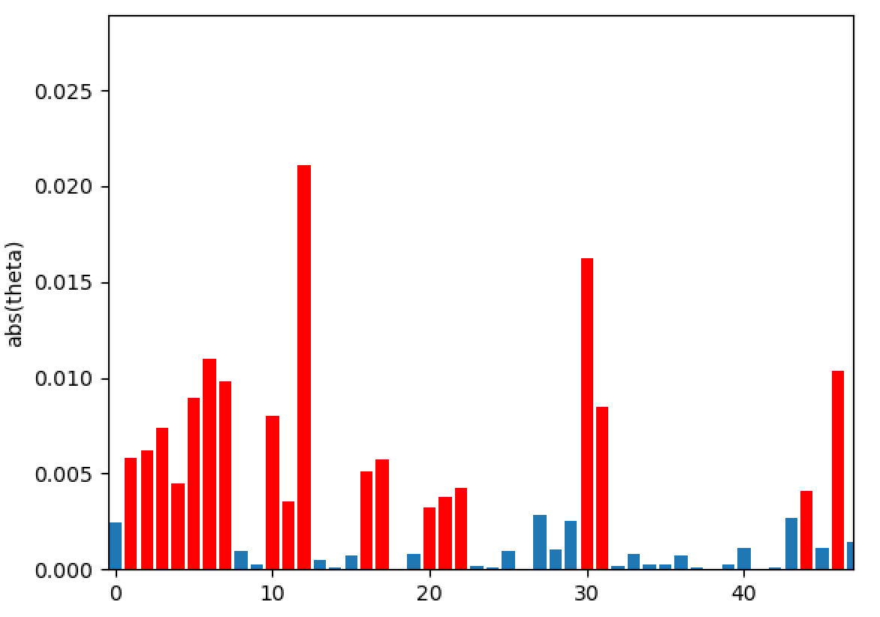
Test (2): Identified relevant inputs
10425 Calculated Cullet Ratio
1950 Canal Temp. Control Pyrometer (2)
10279 Canal Temp. Control (PV)
11282 Chimney Draught Pressure - After Ecomomiser
2922 Closed Bottom Temperature - Downstream Working End (PV)
2913 Closed Bottom Temperature - Port 1 (PV)
2918 Closed Bottom Temperature - Port 6 (PV)
30208 Feeder Speed Measurement Left
11174 Furnace Bottom Temperature 18m D/S of B8
10091 Furnace Load
7474 Lehr Drive Line Shaft Speed
9395 Main Gas Pressure (OP)
7746 Open Crown Temperature - Port 2 (PV)
7673 Open Crown Temperature - Port 5 (PV)
7483 Open Crown Temperature - Port 6 (PV)
11114 Port 2 - 3 Combustion Air Flow RHS (OP)
9400 Port 2 Gas Flow (SP)
135 Total Firm Gas Flow Measurement
30060 U/S Flowing End Air Flow Measurement

Slide 11
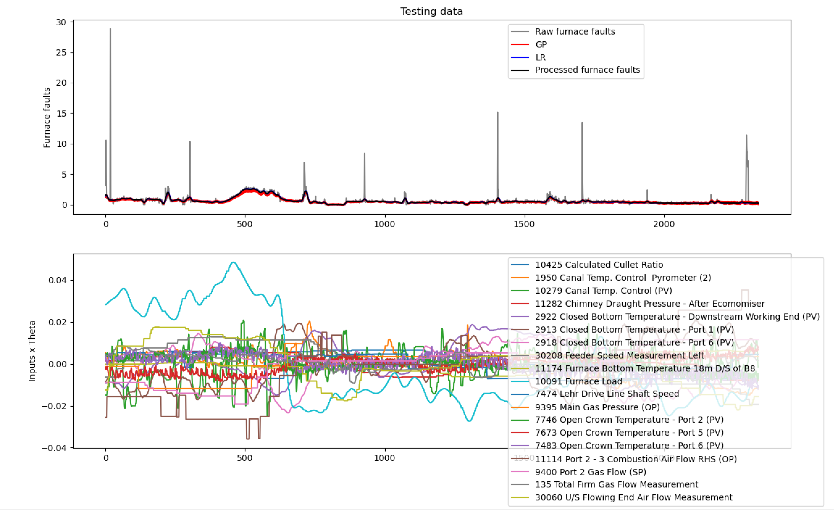
Test (2)

Slide 12
Test (2)
Interesting correlation between furnace load and ‘fault region’?

Slide 13
We identified 7 common relevant inputs from test (1) and (2)
10425 Calculated Cullet Ratio
2913 Closed Bottom Temperature - Port 1 (PV)
2918 Closed Bottom Temperature - Port 6 (PV)
30208 Feeder Speed Measurement Left
10091 Furnace Load
9395 Main Gas Pressure (OP)
9400 Port 2 Gas Flow (SP)

Slide 14
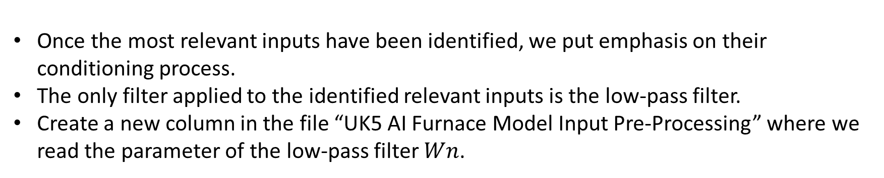
Bespoke filtering
Once the most relevant inputs have been identified, we put emphasis on their conditioning process.
The only filter applied to the identified relevant inputs is the low-pass filter.
Create a new column in the file “UK5 AI Furnace Model Input Pre-Processing” where we read the parameter of the low-pass filter $Wn$.

Slide 15
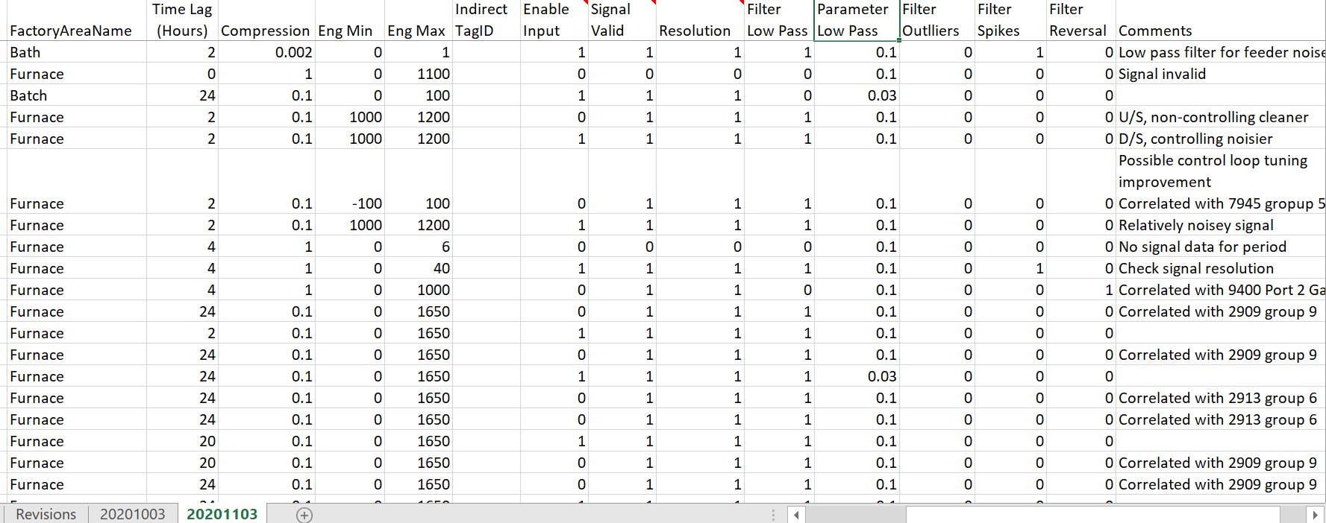
Bespoke filtering

Slide 16
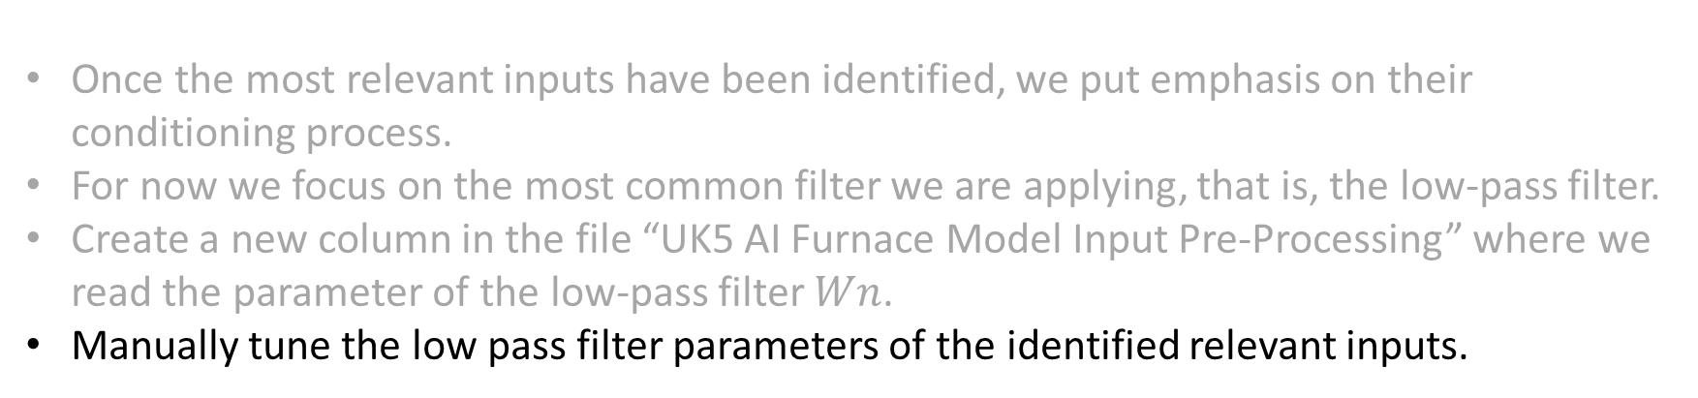
Bespoke filtering
Once the most relevant inputs have been identified, we put emphasis on their conditioning process.
For now we focus on the most common filter we are applying, that is, the low-pass filter.
Create a new column in the file “UK5 AI Furnace Model Input Pre-Processing” where we read the parameter of the low-pass filter $Wn$.
Manually tune the low pass filter parameters of the identified relevant inputs.

Slide 17
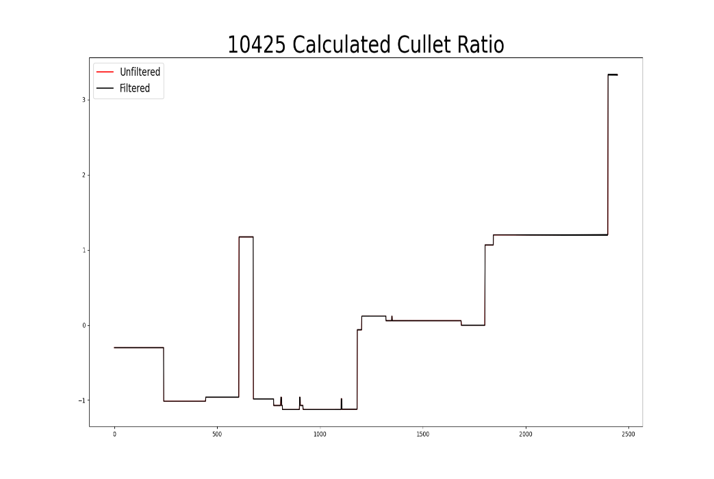
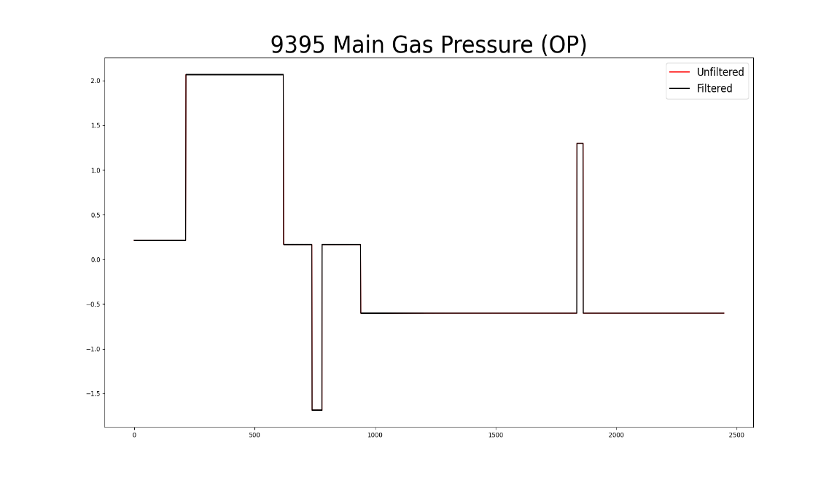
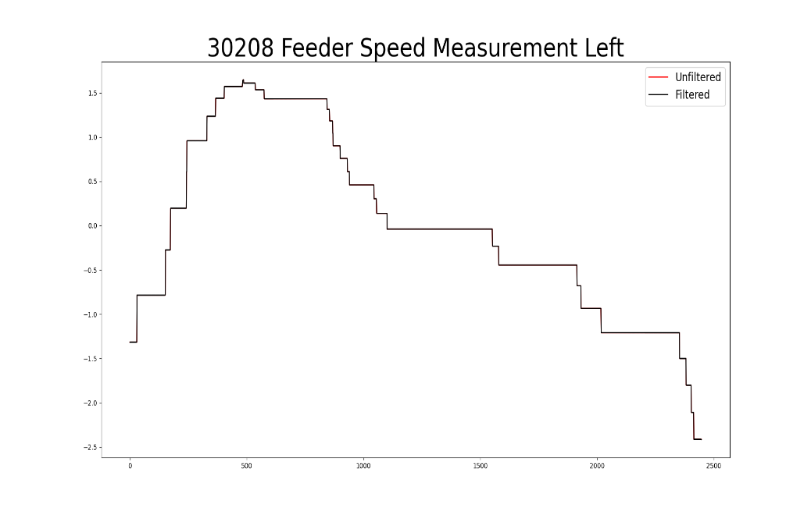
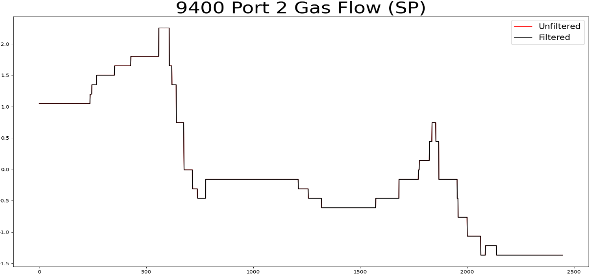
Some of the relevant inputs do not require any filter:
Notes:
Change the label of the plots

Slide 18
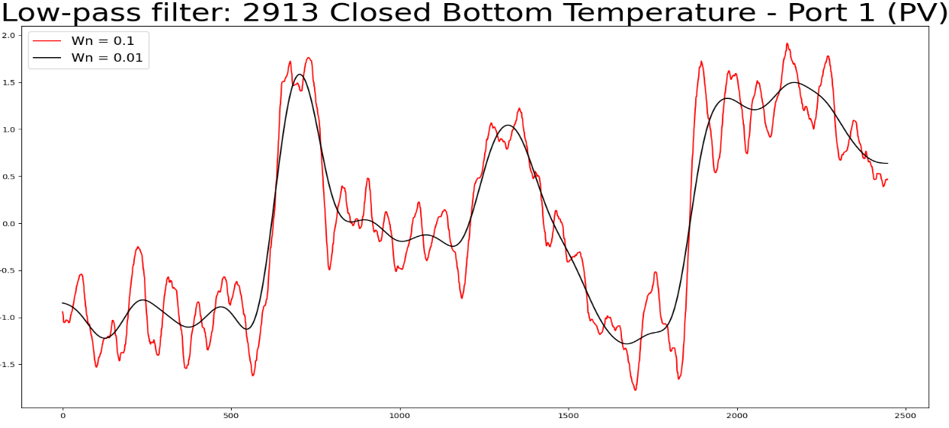
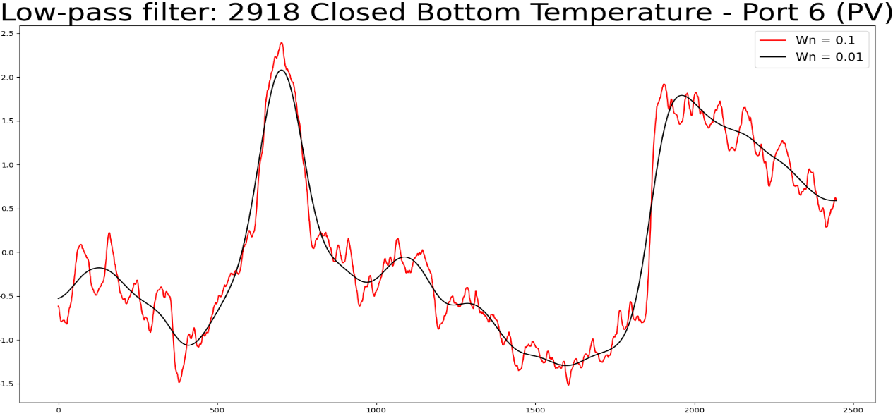
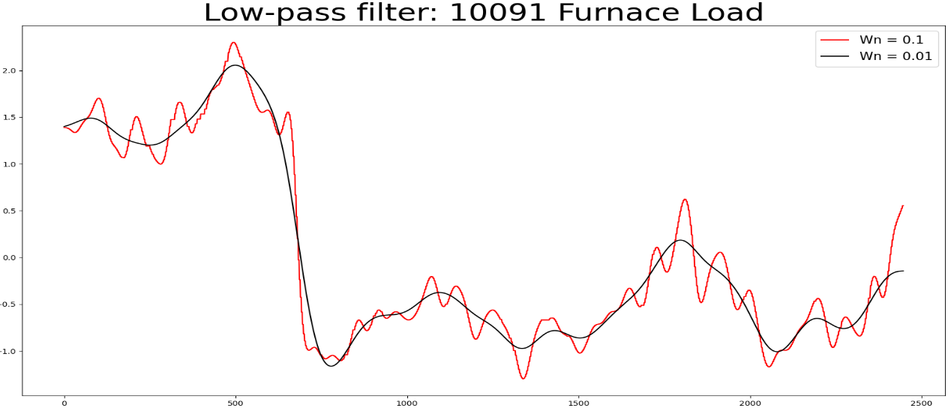
Bespoke filtering (first region) for the common relevant inputs:
Notes:
Change the label of the plots

Slide 19
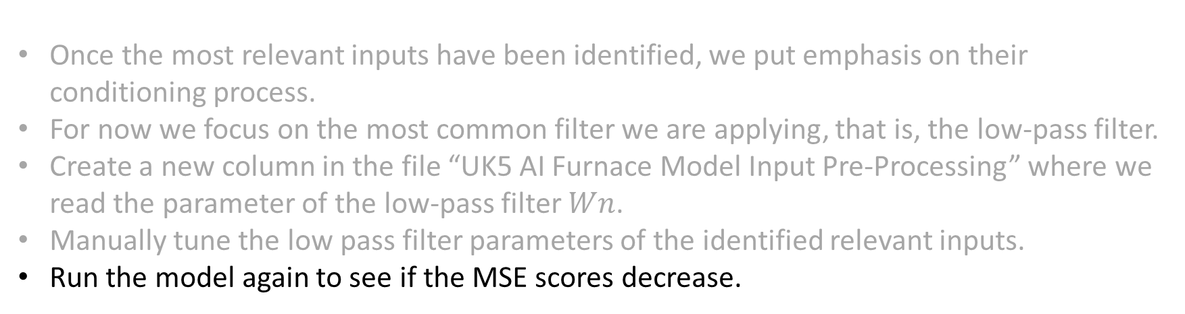
Bespoke filtering
Once the most relevant inputs have been identified, we put emphasis on their conditioning process.
For now we focus on the most common filter we are applying, that is, the low-pass filter.
Create a new column in the file “UK5 AI Furnace Model Input Pre-Processing” where we read the parameter of the low-pass filter $Wn$.
Manually tune the low pass filter parameters of the identified relevant inputs.
Run the model again to see if the MSE scores decrease.

Slide 20
Test (1): Data from the first region is used for training
Clean regions
ISRA 5D
Training
Testing

Slide 21
Test (1): Data from the first region is used for training
Smoothing the signal of the relevant inputs
10425 Calculated Cullet Ratio
2922 Closed Bottom Temperature - Downstream Working End (PV)
2913 Closed Bottom Temperature - Port 1 (PV)
2918 Closed Bottom Temperature - Port 6 (PV)
2921 Closed Bottom Temperature - Upstream Working End (PV)
30208 Feeder Speed Measurement Left
11174 Furnace Bottom Temperature 18m D/S of B8
10091 Furnace Load
7474 Lehr Drive Line Shaft Speed
9395 Main Gas Pressure (OP)
7520 Open Crown Temperature - Upstream Working End (PV)
7443 Outside Ambient Temperature Measurement
11111 Port 2 - 3 Combustion Air Flow LHS (OP)
9400 Port 2 Gas Flow (SP)
9282 Tweel Position
Previously obtained (without smoothing the signal)
10425 Calculated Cullet Ratio
2913 Closed Bottom Temperature - Port 1 (PV)
2918 Closed Bottom Temperature - Port 6 (PV)
2921 Closed Bottom Temperature - Upstream Working End (PV)
30208 Feeder Speed Measurement Left
10091 Furnace Load
9395 Main Gas Pressure (OP)
7520 Open Crown Temperature - Upstream Working End (PV)
7443 Outside Ambient Temperature Measurement
11111 Port 2 - 3 Combustion Air Flow LHS (OP)
9400 Port 2 Gas Flow (SP)
9282 Tweel Position

Slide 22
Test (1): Data from the first region is used for training
Smoothing the signal of the relevant inputs
10425 Calculated Cullet Ratio
2922 Closed Bottom Temperature - Downstream Working End (PV)
2913 Closed Bottom Temperature - Port 1 (PV)
2918 Closed Bottom Temperature - Port 6 (PV)
2921 Closed Bottom Temperature - Upstream Working End (PV)
30208 Feeder Speed Measurement Left
11174 Furnace Bottom Temperature 18m D/S of B8
10091 Furnace Load
7474 Lehr Drive Line Shaft Speed
9395 Main Gas Pressure (OP)
7520 Open Crown Temperature - Upstream Working End (PV)
7443 Outside Ambient Temperature Measurement
11111 Port 2 - 3 Combustion Air Flow LHS (OP)
9400 Port 2 Gas Flow (SP)
9282 Tweel Position
Previously obtained (without smoothing the signal)
10425 Calculated Cullet Ratio
2913 Closed Bottom Temperature - Port 1 (PV)
2918 Closed Bottom Temperature - Port 6 (PV)
2921 Closed Bottom Temperature - Upstream Working End (PV)
30208 Feeder Speed Measurement Left
10091 Furnace Load
9395 Main Gas Pressure (OP)
7520 Open Crown Temperature - Upstream Working End (PV)
7443 Outside Ambient Temperature Measurement
11111 Port 2 - 3 Combustion Air Flow LHS (OP)
9400 Port 2 Gas Flow (SP)
9282 Tweel Position
common

Slide 23
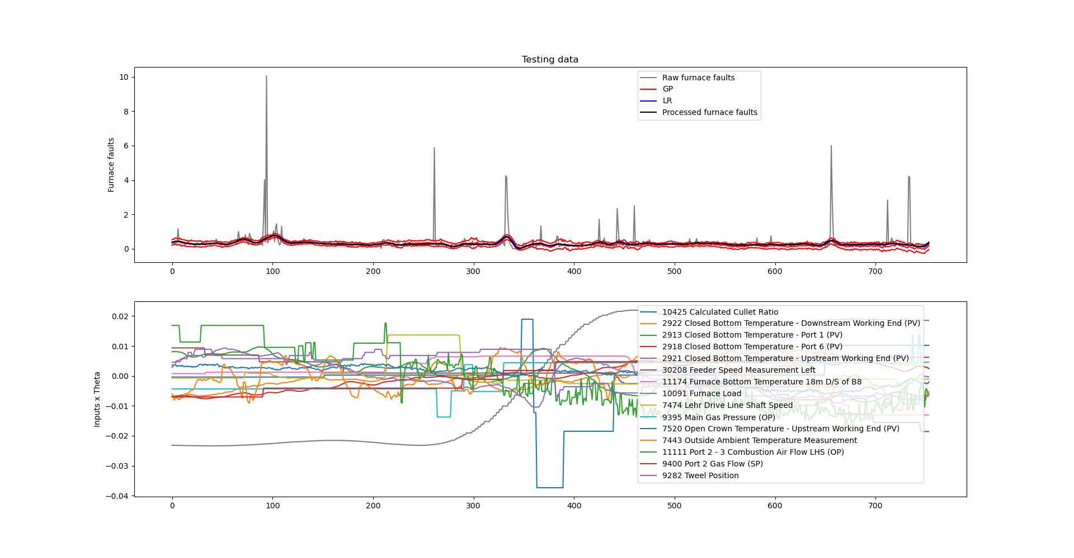
Test (1): After smoothing the relevant input signals
More relevant than in the previous case

Slide 24
Test (2): Data from the second region is used for training
Clean regions
ISRA 5D
Testing
Training

Slide 25
Test (2): Data from the first region is used for training
Previously obtained (without smoothing the signal)
10425 Calculated Cullet Ratio
1950 Canal Temp. Control Pyrometer (2)
10279 Canal Temp. Control (PV)
11282 Chimney Draught Pressure - After Ecomomiser
2922 Closed Bottom Temperature - Downstream Working End (PV)
2913 Closed Bottom Temperature - Port 1 (PV)
2918 Closed Bottom Temperature - Port 6 (PV)
30208 Feeder Speed Measurement Left
11174 Furnace Bottom Temperature 18m D/S of B8
10091 Furnace Load
7474 Lehr Drive Line Shaft Speed
9395 Main Gas Pressure (OP)
7746 Open Crown Temperature - Port 2 (PV)
7673 Open Crown Temperature - Port 5 (PV)
7483 Open Crown Temperature - Port 6 (PV)
11114 Port 2 - 3 Combustion Air Flow RHS (OP)
9400 Port 2 Gas Flow (SP)
135 Total Firm Gas Flow Measurement
30060 U/S Flowing End Air Flow Measurement
Smoothing the signal of the relevant inputs
10425 Calculated Cullet Ratio
1950 Canal Temp. Control Pyrometer (2)
10279 Canal Temp. Control (PV)
11282 Chimney Draught Pressure - After Ecomomiser
2922 Closed Bottom Temperature - Downstream Working End (PV)
2913 Closed Bottom Temperature - Port 1 (PV)
30208 Feeder Speed Measurement Left
10091 Furnace Load
7474 Lehr Drive Line Shaft Speed
9395 Main Gas Pressure (OP)
7673 Open Crown Temperature - Port 5 (PV)
7483 Open Crown Temperature - Port 6 (PV)
11114 Port 2 - 3 Combustion Air Flow RHS (OP)
9400 Port 2 Gas Flow (SP)
135 Total Firm Gas Flow Measurement
30060 U/S Flowing End Air Flow Measurement

Slide 26
Test (2): Data from the first region is used for training
common
Previously obtained (without smoothing the signal)
10425 Calculated Cullet Ratio
1950 Canal Temp. Control Pyrometer (2)
10279 Canal Temp. Control (PV)
11282 Chimney Draught Pressure - After Ecomomiser
2922 Closed Bottom Temperature - Downstream Working End (PV)
2913 Closed Bottom Temperature - Port 1 (PV)
2918 Closed Bottom Temperature - Port 6 (PV)
30208 Feeder Speed Measurement Left
11174 Furnace Bottom Temperature 18m D/S of B8
10091 Furnace Load
7474 Lehr Drive Line Shaft Speed
9395 Main Gas Pressure (OP)
7746 Open Crown Temperature - Port 2 (PV)
7673 Open Crown Temperature - Port 5 (PV)
7483 Open Crown Temperature - Port 6 (PV)
11114 Port 2 - 3 Combustion Air Flow RHS (OP)
9400 Port 2 Gas Flow (SP)
135 Total Firm Gas Flow Measurement
30060 U/S Flowing End Air Flow Measurement
Smoothing the signal of the relevant inputs
10425 Calculated Cullet Ratio
1950 Canal Temp. Control Pyrometer (2)
10279 Canal Temp. Control (PV)
11282 Chimney Draught Pressure - After Ecomomiser
2922 Closed Bottom Temperature - Downstream Working End (PV)
2913 Closed Bottom Temperature - Port 1 (PV)
30208 Feeder Speed Measurement Left
10091 Furnace Load
7474 Lehr Drive Line Shaft Speed
9395 Main Gas Pressure (OP)
7673 Open Crown Temperature - Port 5 (PV)
7483 Open Crown Temperature - Port 6 (PV)
11114 Port 2 - 3 Combustion Air Flow RHS (OP)
9400 Port 2 Gas Flow (SP)
135 Total Firm Gas Flow Measurement
30060 U/S Flowing End Air Flow Measurement
Reduced number of relevant inputs

Slide 27
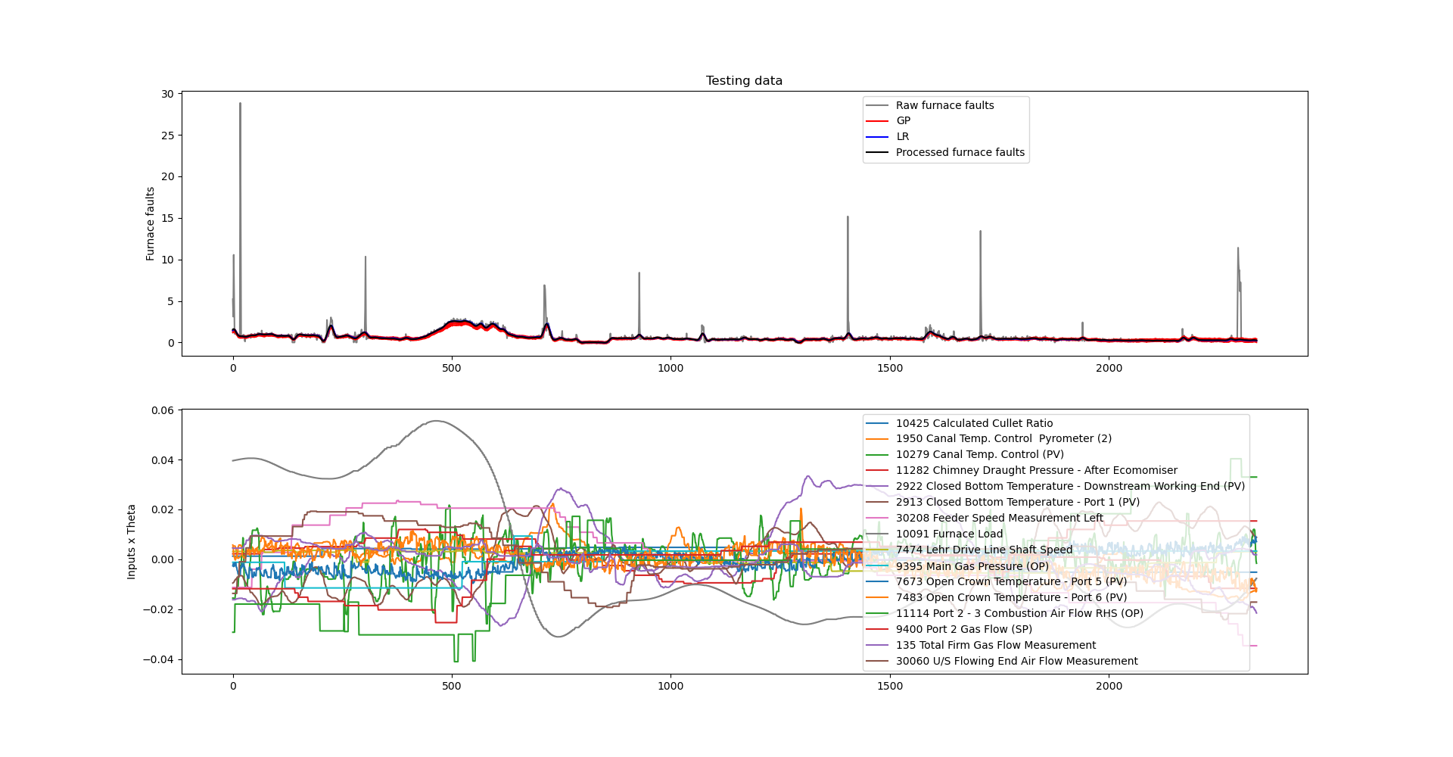
Test (2): After smoothing the relevant input signals
AS important as in the previous case, but slightly different shape

Slide 28
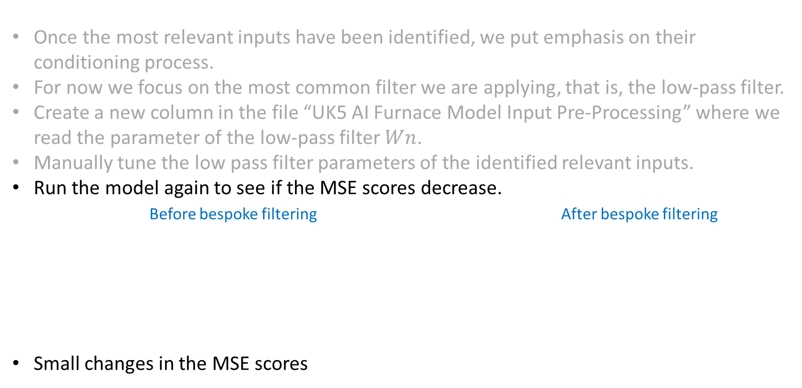
Bespoke filtering
Once the most relevant inputs have been identified, we put emphasis on their conditioning process.
For now we focus on the most common filter we are applying, that is, the low-pass filter.
Create a new column in the file “UK5 AI Furnace Model Input Pre-Processing” where we read the parameter of the low-pass filter $Wn$.
Manually tune the low pass filter parameters of the identified relevant inputs.
Run the model again to see if the MSE scores decrease.
Before bespoke filtering After bespoke filtering
Small changes in the MSE scores
 | LR | GP
Test (1) | 0.00043 | 0.00393
Test (2) | 0.00129 | 0.00597
Score | 0.00086 | 0.00495
 | LR | GP
Test (1) | 0.00039 | 0.00440
Test (2) | 0.00172 | 0.00631
Score | 0.00105 | 0.00535

Slide 29
Next activities
Still working on test for the remove spikes pre-processing box (programming time).
Select regions without exclusion periods from the new dataset provided (2020 – 2021).
Re-run the model with the expanded training dataset.
Change the time lags randomly.

Slide 30
Thank you for your attention. ANY QUESTIONS?

